Slide 1


Arushi Kapoor
16th April 2024

Slide 2

Outline
Executive Summary
Introduction
Methodology
Results
Conclusion

Slide 3
Executive Summary
The objective of the capstone project is to determine the price of each launch. This is done by gathering information about Space X and creating dashboards.
It is also found whether SpaceX will reuse the first stage. Instead of using rocket science to determine if the first stage will land successfully, we have trained a machine learning model and used public information to predict if SpaceX will reuse the first stage.

Slide 4
Introduction
Using the Falcon9 data we are trying to draw conclusions if first stage will be re-used and hence determine the cost of the launch.
Stages of the capstone project:
Collecting the data - API and Web Scrapping
Data Wrangling - EDA to find some patterns in that data.
Exploratory analysis with SQL
Exploratory analysis with Pandas and Matplotlib
Interactive Visual Analytics
Predictive Analysis

Slide 5

Section 1

Slide 6
Methodology
Executive Summary
Data collection methodology:
Data is collected via API and Web Scrapping
Perform data wrangling
EDA to find some patterns in the data
Perform exploratory data analysis (EDA) using visualization and SQL
Perform interactive visual analytics using Folium and Plotly Dash
Perform predictive analysis using classification models
Data was trained on several models like Logistic Regression, SVM, Decision Tree and KNN to see which gives best accuracy
Hyperparameters for the models was selected by Grid Search approach.

Slide 7
Data Collection: API
1. Request and parse the SpaceX launch data using the GET request
Decode the response content as a Json using .json() and turn it into a Pandas dataframe using .json_normalize()
Use the API again to get information about the launches using the IDs given for each launch. Specifically we will be using columns rocket, payloads, launchpad, and cores.
2. Filter the dataframe to only include `Falcon 9` launches
remove the Falcon 1 launches keeping only the Falcon 9 launches. Filter the data dataframe using the BoosterVersion column to only keep the Falcon 9 launches. Save the filtered data to a new dataframe called data_falcon9.

Slide 8
Data Collection: Web Scrapping
Web scrap Falcon 9 launch records with BeautifulSoup:
Extract a Falcon 9 launch records HTML table from Wikipedia
Parse the table and convert it into a Pandas data frame

Slide 9
Data Collection – SpaceX API
Link to Notebook:
Click here
Request and parse the SpaceX launch data using the GET request
Decode response as json
-> Dataframe->.json_normalise()
Filter the dataframe to only include `Falcon 9` launches

Slide 10
Data Collection - Scraping
Link to notebook
Click here
Request Rocket launch data from Wikipedia
Web Scrap records with BeautifulSoup()
Parse Table and convert to Pandas DataFrame

Slide 11
Data Wrangling
Calculate the number of launches on each site
Performed some Exploratory Data Analysis (EDA) to find some patterns in the data and determine what would be the label for training supervised models.
Calculate the number and occurrence of each orbit
Github Link
Click here
Calculate the number and occurrence of mission outcome of the orbits
Create a landing outcome label from Outcome column

Slide 12
EDA with Data Visualization
Charts Plotted:
1. Scatter Plot- Visualize the relationship between Flight Number and Launch Site, Visualize the relationship between Payload and Launch Site etc
2. Bar Chart - Visualize the relationship between success rate of each orbit type
3. Line chart- Visualize the launch success yearly trend
Github link – Click here

Slide 13
EDA with SQL
SQL queries carried out to do the following:
Display the names of the unique launch sites in the space mission
Display 5 records where launch sites begin with the string 'CCA'
Display the total payload mass carried by boosters launched by NASA (CRS)
Display average payload mass carried by booster version F9 v1.1
List the names of the boosters which have success in drone ship and have payload mass greater than 4000 but less than 6000
List the names of the booster_versions which have carried the maximum payload mass. Use a subquery
List the records which will display the month names, failure landing_outcomes in drone ship ,booster versions, launch_site for the months in year 2015.
Github link – click here

Slide 14
Build an Interactive Map with Folium
Folium.Marker and folium.circle are added for each launch site on map
Success/failed launches for each site on the map are marked
Folium.Marker and folium.circle are added for each launch result in spacex_df
Distances between a launch site to its proximities is calculated
Github link – click here

Slide 15
Build a Dashboard with Plotly Dash
Pie chart shows success count for all launch sites
KSC LC-39A has the most number of successful launches
CCAFS SLC 40 has the least number of successful launches
Scatter plot shows success count on Payload masses for all sites
Github link – click here

Slide 16
Predictive Analysis (Classification)
Perform exploratory Data Analysis and determine Training Labels
create a column for the class
Standardize the data
Split into training data and test data
Find best Hyperparameter for SVM, Classification Trees and Logistic Regression – Grid Search
Find the method performs best using test data
Github link – click here

Slide 17
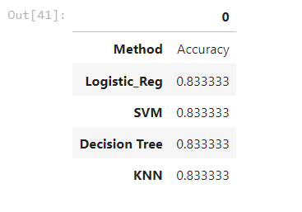
Results
All models performed equally well with accuracy 83.3%

Slide 18
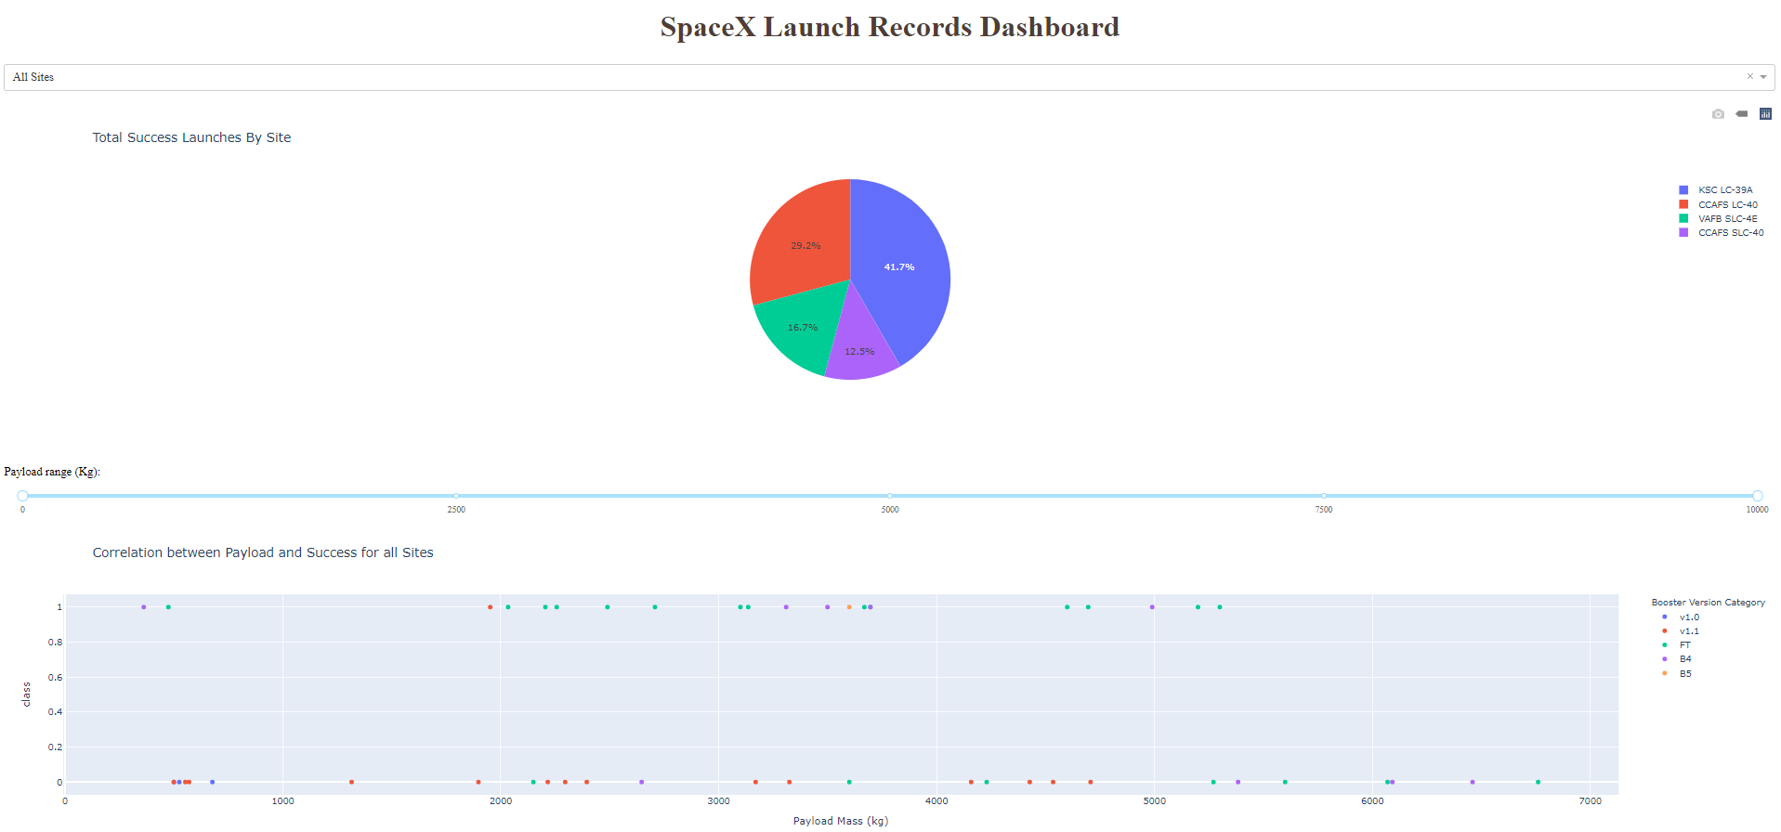
Results
Dashboard

Slide 19

Section 2

Slide 20
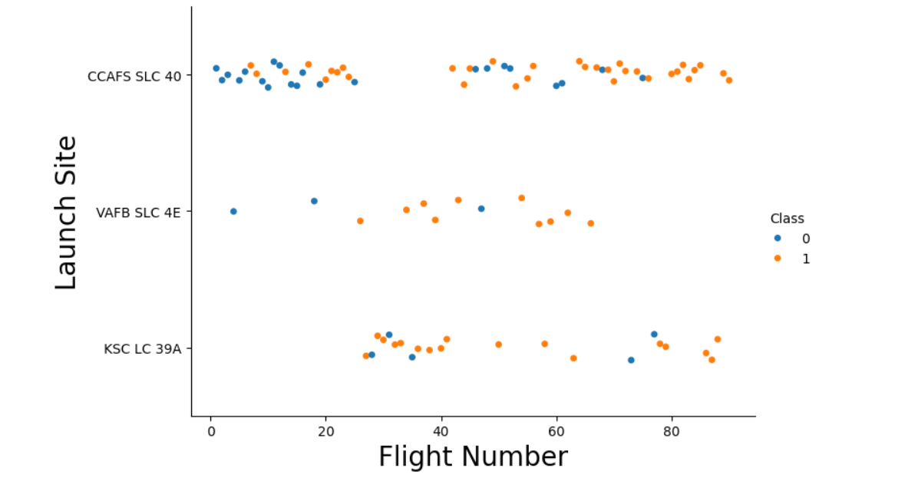
Flight Number vs. Launch Site

Slide 21
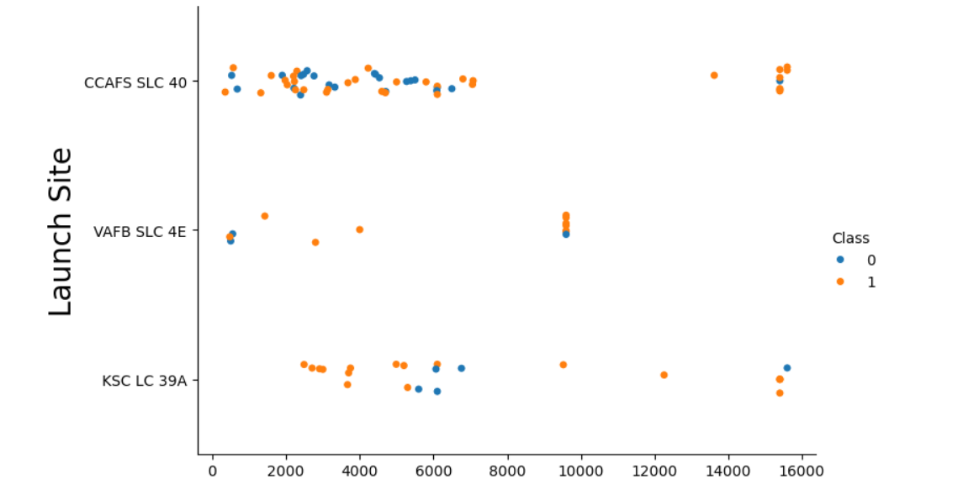
Payload vs. Launch Site

Slide 22
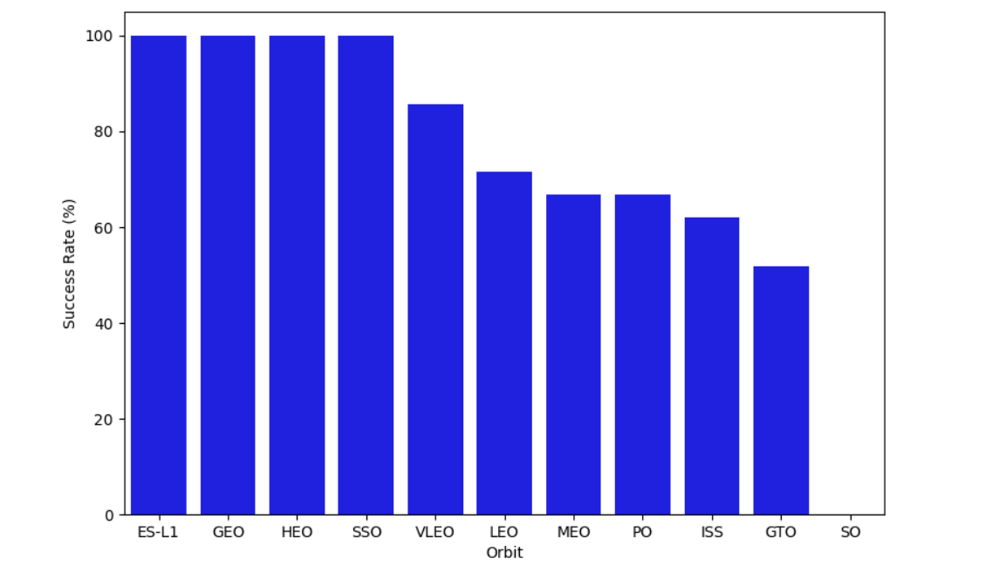
Success Rate vs. Orbit Type

Slide 23
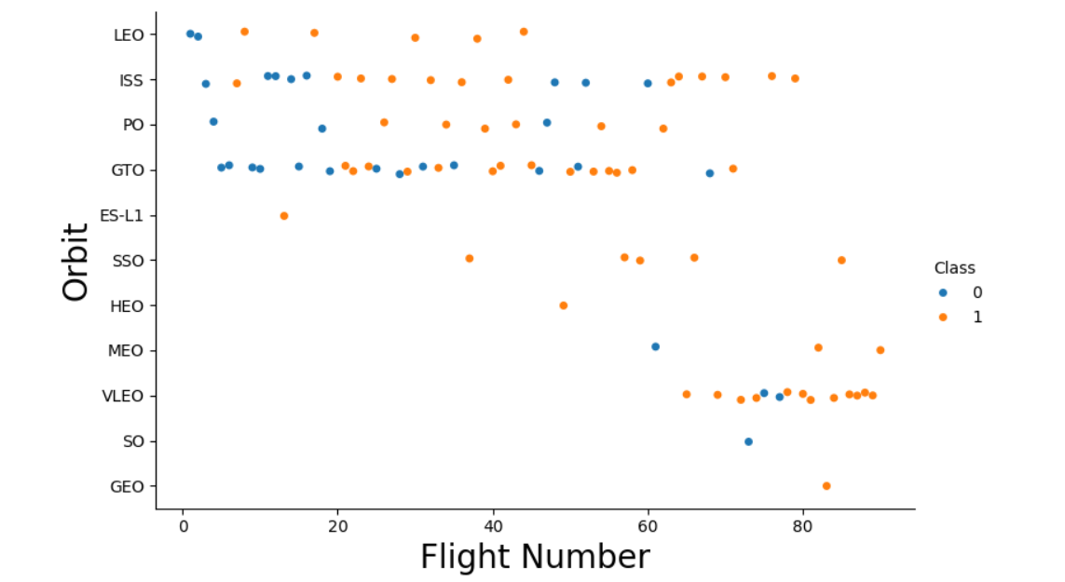
Flight Number vs. Orbit Type

Slide 24
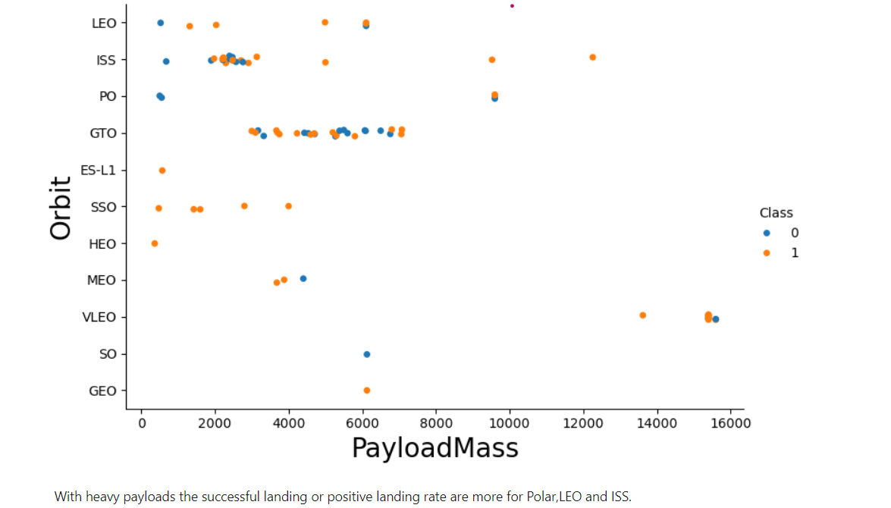
Payload vs. Orbit Type

Slide 25
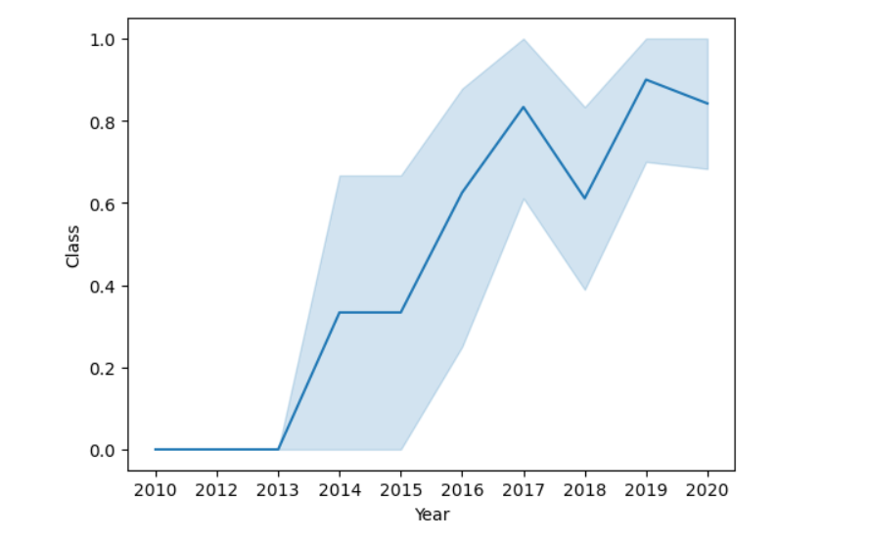
Launch Success Yearly Trend

Slide 26
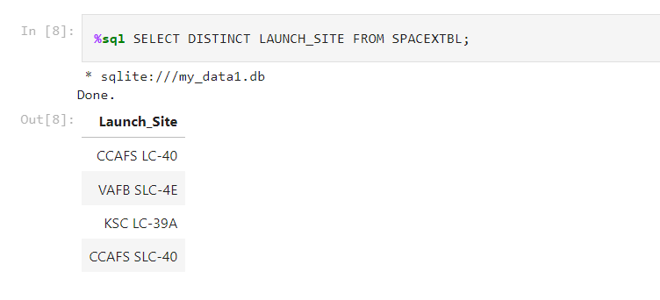
All Launch Site Names

Slide 27
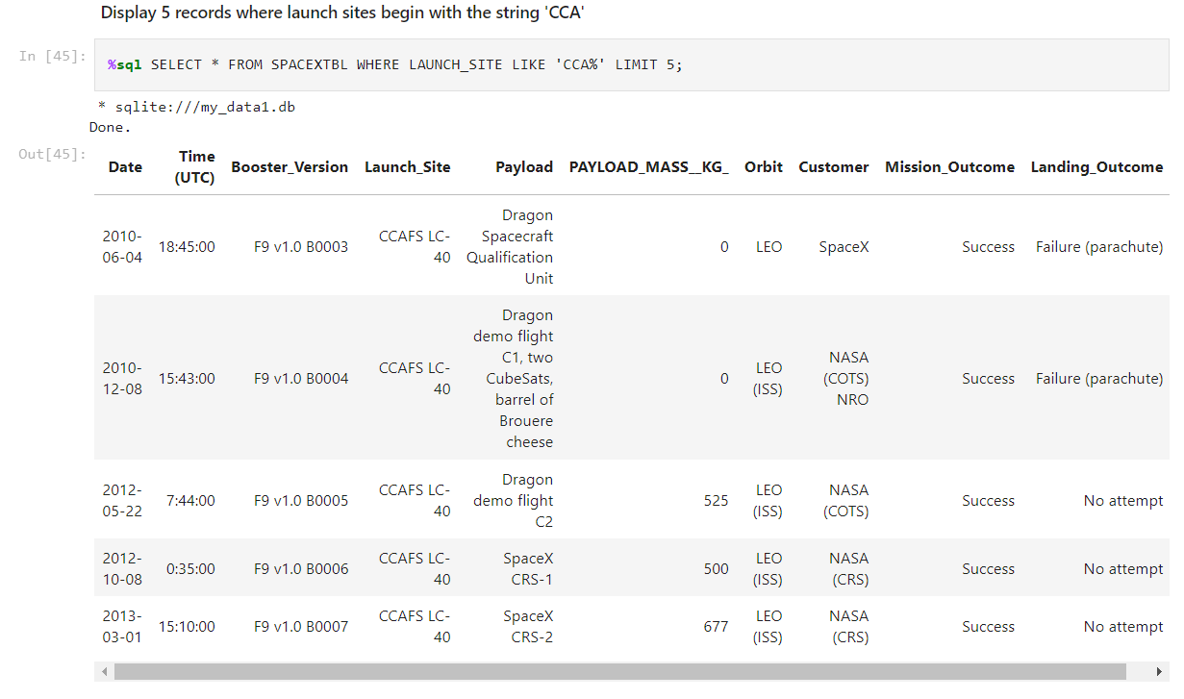
Launch Site Names Begin with 'CCA'

Slide 28
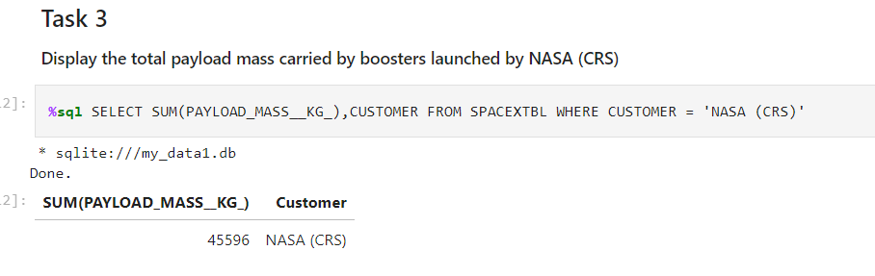
Total Payload Mass

Slide 29
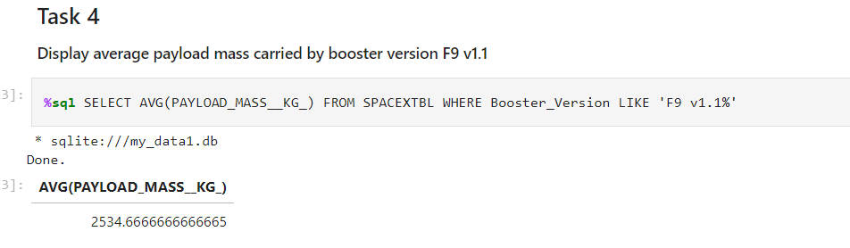
Average Payload Mass by F9 v1.1

Slide 30
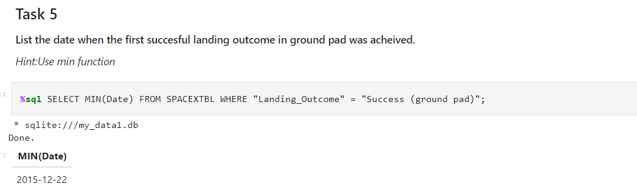
First Successful Ground Landing Date

Slide 31
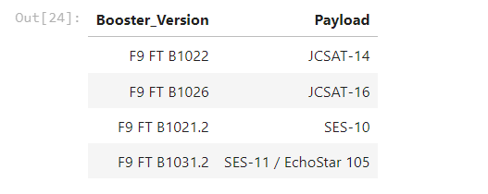
Successful Drone Ship Landing with Payload between 4000 and 6000
%sql SELECT Booster_Version, Payload FROM SPACEXTBL WHERE "Landing_Outcome" = "Success (drone ship)" AND PAYLOAD_MASS__KG_ > 4000 and PAYLOAD_MASS__KG_ <6000

Slide 32
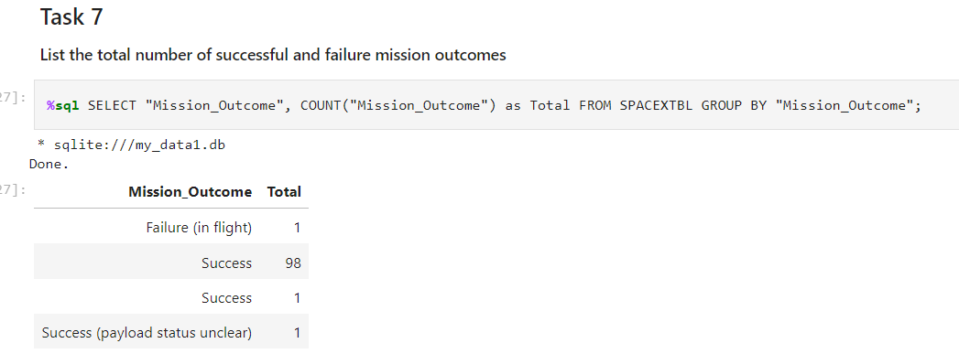
Total Number of Successful and Failure Mission Outcomes

Slide 33
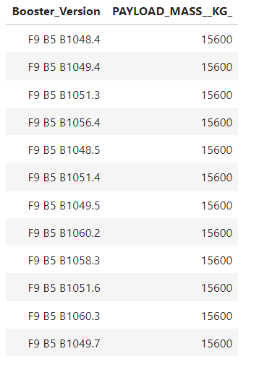
Boosters Carried Maximum Payload
%sql SELECT Booster_Version, PAYLOAD_MASS__KG_ FROM SPACEXTBL WHERE PAYLOAD_MASS__KG_ = (SELECT MAX(PAYLOAD_MASS__KG_) FROM SPACEXTBL)

Slide 34
2015 Launch Records
%sql SELECT substr(Date, 6, 2) AS Month,"Booster_Version", "Launch_Site", Payload, "PAYLOAD_MASS__KG_", "Mission_Outcome", "Landing _Outcome" FROM SPACEXTBL WHERE substr(Date,0,5)='2015' AND "Landing _Outcome" = 'Failure (drone ship)';

Slide 35
Rank Landing Outcomes Between 2010-06-04 and 2017-03-20
%sql SELECT * FROM SPACEXTBL WHERE "Landing _Outcome" LIKE 'Success%' AND (Date BETWEEN '2010-06-04' AND '2017-03-20') ORDER BY Date DESC;

Slide 36

Section 3

Slide 37
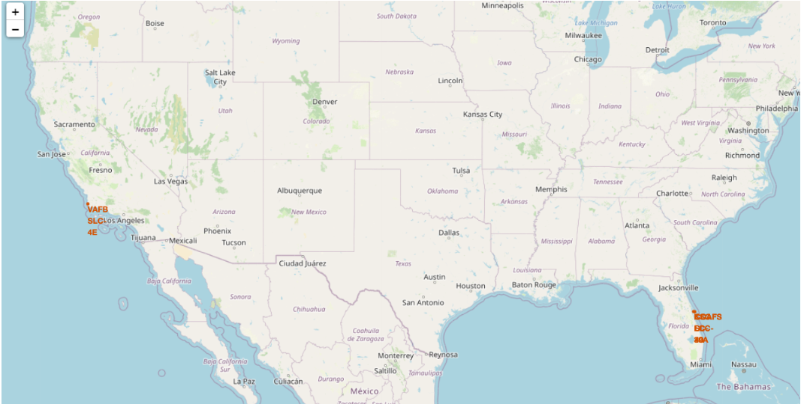
Folium Map: map with marked launch sites

Slide 38
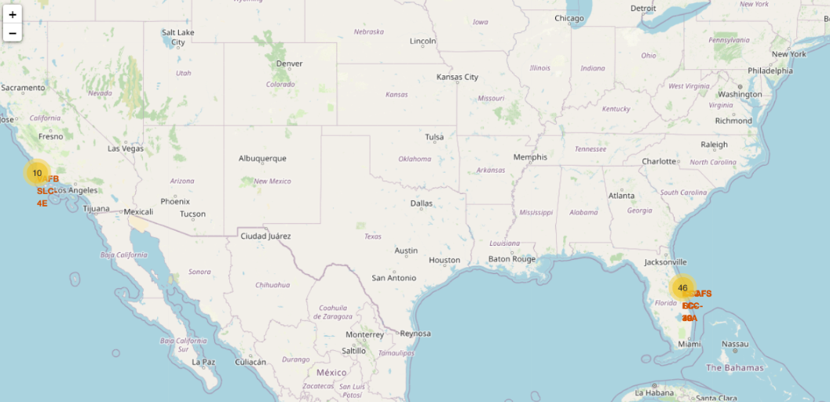
Folium Map: Mark the success/failed launches for each site on the map

Slide 39
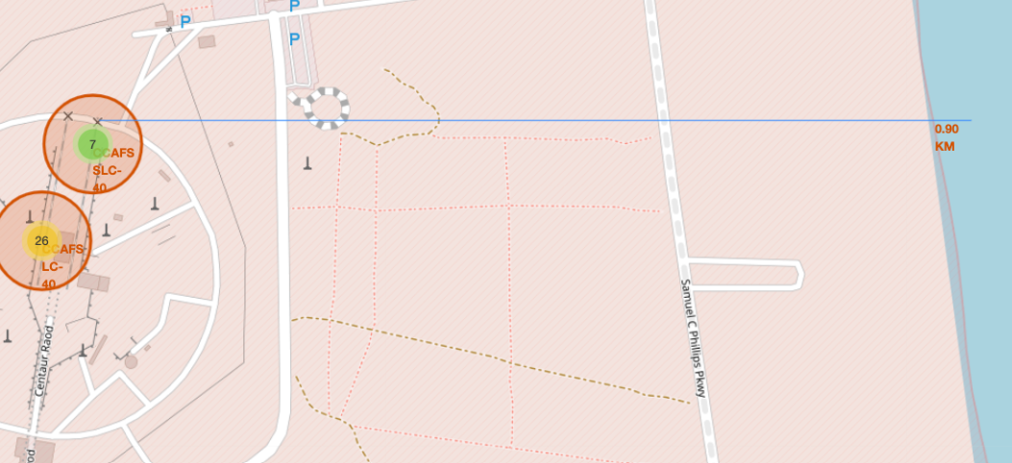
Folium Map: Calculate the distances between a launch site to its proximities

Slide 40

Section 4

Slide 41
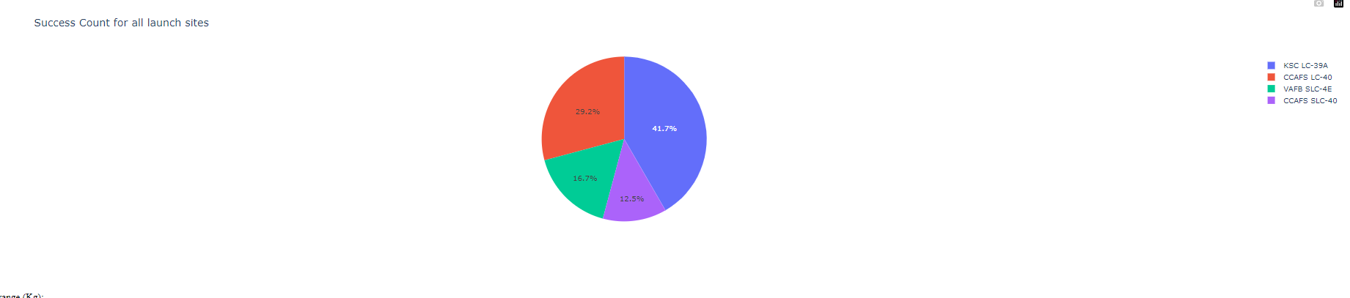
Dashboard: Pie chart

Slide 42
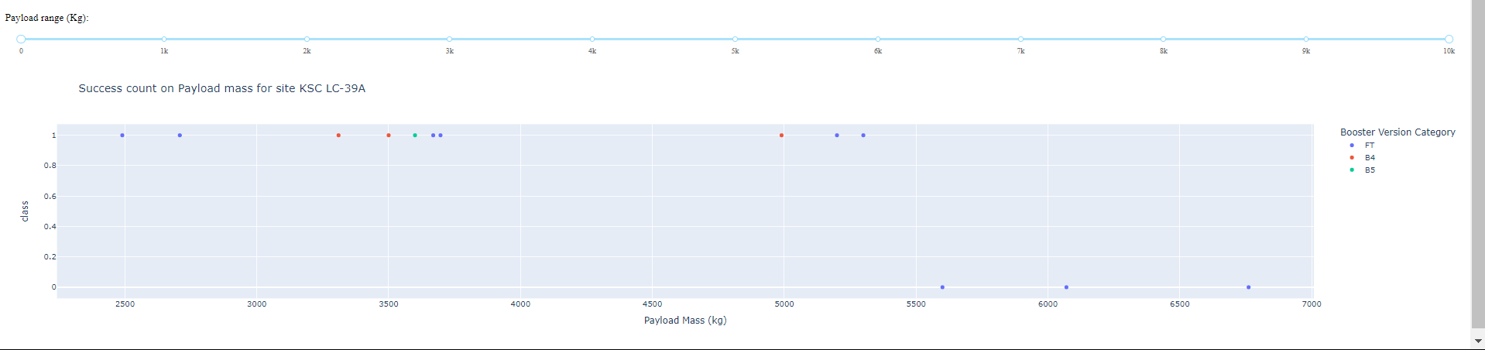
Dashboard

Slide 43

Section 5

Slide 44
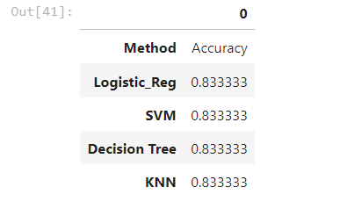
Classification Accuracy
All models performed equally well with an accuracy of 83.3%

Slide 45
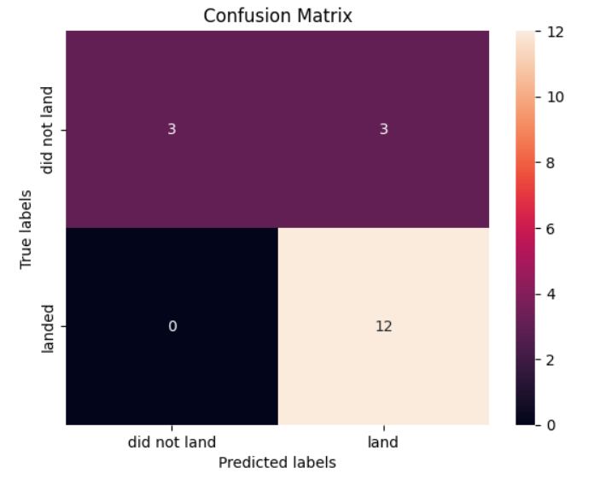
Confusion Matrix
All models performed equally well with an accuracy of 83.3%

Slide 46
Conclusions
Data collection with API and Web Scrapping
EDA with SQL
EDA with data visualization
Data trained on several models – Logistic Regression, KNN, Decision Trees, SVM
Tunning of Hyperparameter using Grid Search
Accuracy: 83.3% for all the models

Slide 47


